Slide 1
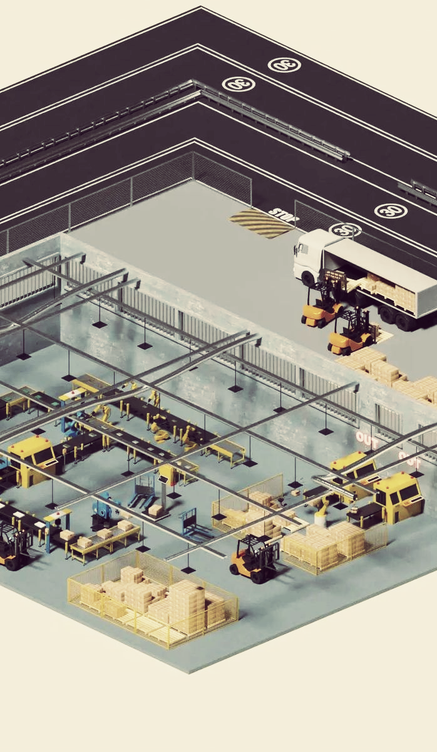
Smart Twin - Digital Twin for Industrial Monitoring
Team - Vecna
Sahil Kesharwani
Shreejoy Sarkar

Slide 2



The Industrial Monitoring Challenge
Industrial plants rely on manual monitoring of machinery → prone to human error.
Existing systems are often complex, expensive, and lack real-time visibility.
Unexpected machine failures cause: Costly downtime, Safety risks, Low productivity
Industries need a simple, intuitive, real-time system to monitor all instruments and detect issues early.

Slide 3
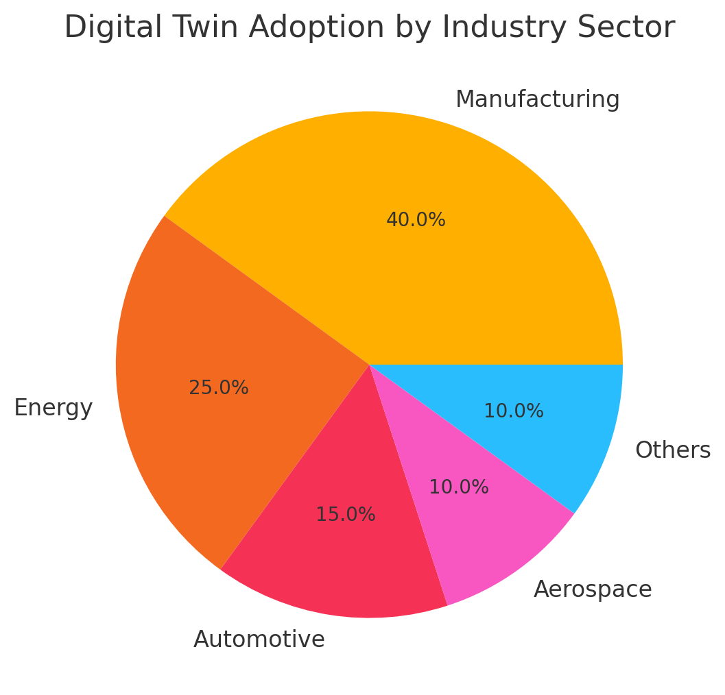
Industry Landscape & Opportunity
Power plants and processing units
AUTOMATION & INSTRUMENTATION COMPANIES
Manufacturing industries

Slide 4
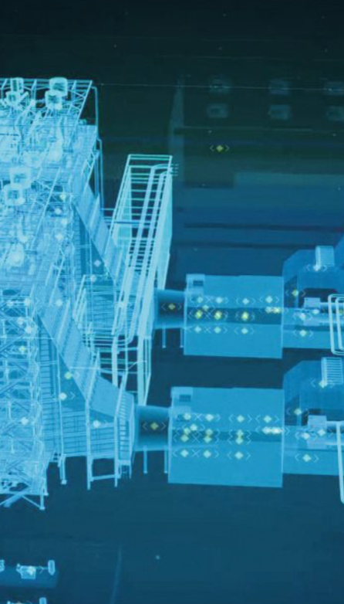
Smart Twin - Digital Twin for Industrial Monitoring
Our Innovation: SmartTwin 360, a is a real-time digital twin platform that auto-generates a 3D replica of a manufacturing unit, streams real-time IoT sensor data, uses AI-based anomaly detection, and offers predictive maintenance insights through a clean, intuitive dashboard accessible on the web.

Slide 5
Key Features of Smart Twin
Real-time Data Integration
Predictive Analytics
Smart Twins integrate real-time data from various sensors, control systems, and other data sources to create a comprehensive digital representation of the physical asset or system.
Smart Twins leverage advanced analytics and machine learning algorithms to predict equipment failures, optimize maintenance schedules, and forecast production output.
Process Optimization
Automated Monitoring
Scenario Modeling
Smart Twins provide the ability to simulate and optimize industrial processes, enabling operators to make informed decisions that improve efficiency, quality, and overall performance.
Smart Twins continuously monitor the performance of the physical asset or system, providing real-time alerts and notifications to help operators identify and address issues before they escalate.
Smart Twins allow users to model and simulate different scenarios, enabling them to evaluate the impact of changes and make informed decisions before implementing them in the physical world.

Slide 6
Benefits of Smart Twin
Improved Efficiency
Smart Twin technology enables real-time monitoring and optimization of industrial processes, leading to more efficient utilization of resources, energy, and production workflows.
Reduced Downtime
By leveraging predictive analytics, Smart Twin can anticipate equipment failures and enable proactive maintenance, significantly reducing unplanned downtime and improving overall equipment effectiveness.
Optimized Asset Performance
The comprehensive digital representation of physical assets provided by Smart Twin allows for continuous optimization, ensuring that equipment and systems operate at their maximum potential, enhancing productivity and output.

Slide 7






Smart Twin Tech Architecture
Data Integration
Analytics Engine
Simulation and Modeling
Visualization and Dashboards
Connectivity and Integration
Edge Computing and IoT
Smart Twin integrates real-time data from various sensors and devices, as well as historical data from enterprise systems, to create a comprehensive digital representation of the physical asset or system.
The Smart Twin platform employs advanced analytics algorithms, including machine learning and artificial intelligence, to process the integrated data and generate insights, predictions, and optimization recommendations.
The digital twin model can be used to simulate various scenarios, test hypotheses, and optimize the performance of the physical asset or system without disrupting operations.
Smart Twin provides intuitive dashboards and visualizations that allow users to interact with the digital twin, monitor real-time performance, and make data-driven decisions.
Smart Twin seamlessly integrates with existing enterprise systems, such as ERP, SCADA, and MES, to ensure a holistic view of the industrial ecosystem and enable informed decision-making.
Smart Twin leverages edge computing and the Internet of Things (IoT) to collect, process, and transmit data from the physical asset or system, enabling real-time monitoring and response.

Slide 8







Business Model
Subscription Model: Pay-per-machine monitoring
API Licensing: Digital twin generation API
Maintenance Analytics Reports: Monthly paid reports
Enterprise Plan: Custom installations

Slide 9
Vision & Impact
1
Transform manufacturing units by giving them a real-time mirror of their operations.
2
Reduce failures, improve safety, and increase productivity.
3
Make digital twin technology accessible, affordable, and scalable for all sizes of industries.
4
SmartTwin aims to be the simplest pathway to Industry 4.0 adoption.

